Slide 1
546 HW2 report 8 puzzles game
Zhenyan Liu

Slide 2

Rules for game:
Can move tiles to empty spot perpendicularly or horizontally.

Slide 3
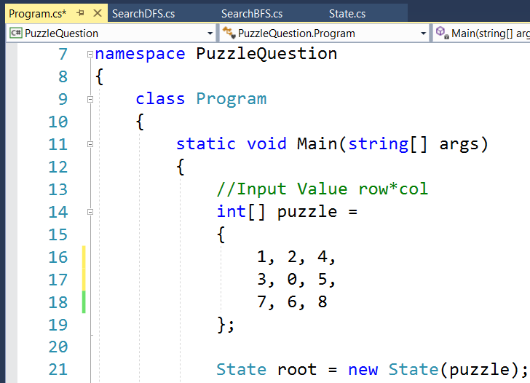

Tiles in Code:
0---empty position
Target position:
Output vs Input

Slide 4
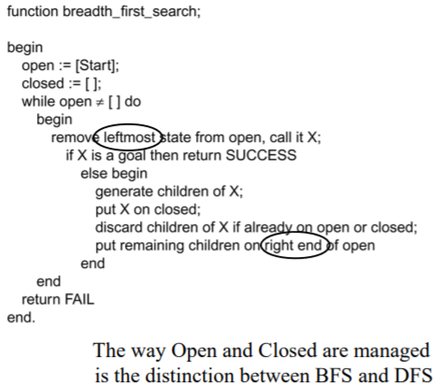
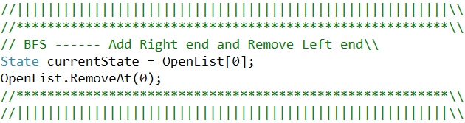
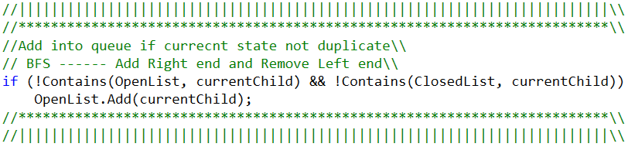
BFS method:
BFS Algorithm for lecture slide
BFS method in my code

Slide 5
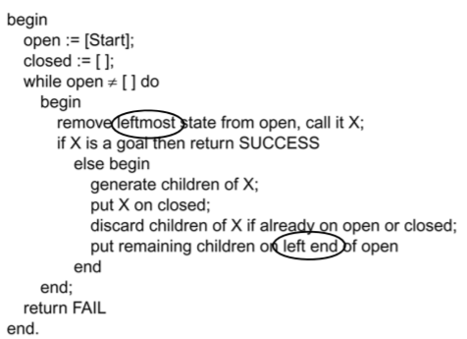
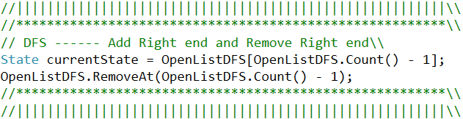
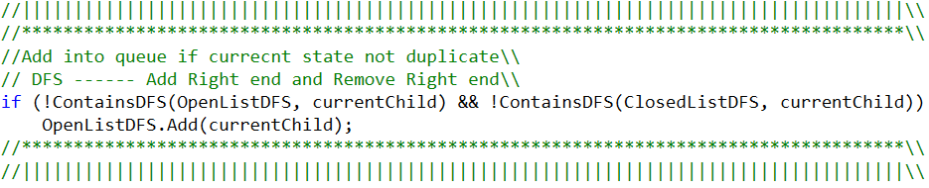
DFS method:
DFS Algorithm for lecture slide
DFS method in my code

Slide 6
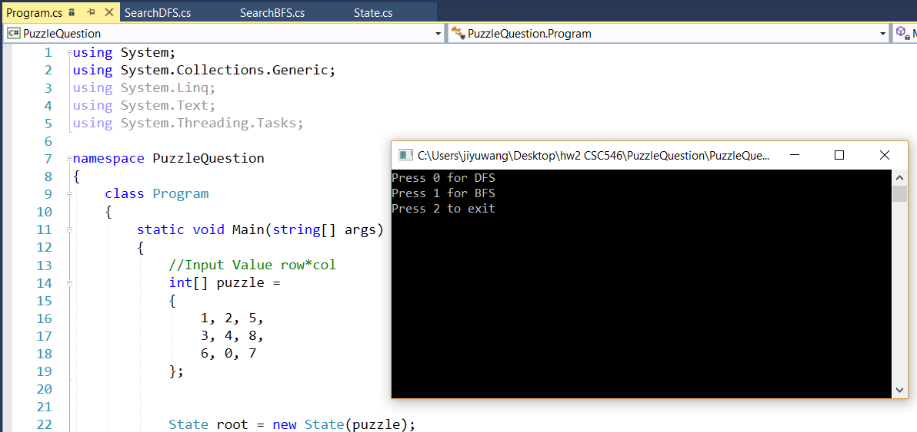
Running the code:
Press 0 : DFS
Press 1 : BFS
Press 2 : Exit

Slide 7




Test Case1: BFS

Slide 8
Test Case1: DFS

Slide 9
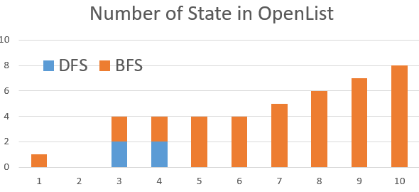
Test Case1: BFS vs DFS

Slide 10
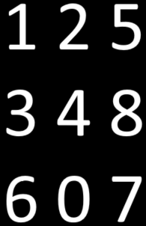
Test Case2: BFS vs DFS
This case takes long time to run with both BFS and DFS method.
On my laptop running this case take more than 2hrs.
We need other algorithm to solve this case.

Slide 11
Comments:
Both DFS and BFS applied in this 8 puzzles game.
BFS is quicker than DFS in my test case.
Solving the 8 puzzles game may take a long time since this problem will have 1x2x3x4x5x6x7x8x9 = 362,880 different states.
The case1 in this report is the case in a good position, I test other cases similar to case2, some of them will take long time to solve. We need to apply other method to accelerate it.

